Slide 1
Mendel’s laws
By
Dr.B.padmaja
D.N.r. college

Slide 2
Mendel’s laws
Law of dominance
Law of segregation
Law y independent assortment

Slide 3
Law of dominance
One factor in a pair may Mask or prevent the expression of the other
Each organism is formed of a bundle of characters
Each character is controlled by a pair of genes (T or t)
Each factor of the paired factors (Tt) is responsible for the expression of a particular variety (tall or dwarf) of a character (height)
Variety that appeared in F1 generation – Dominant
Did not appear in F1 --- recessive

Slide 4
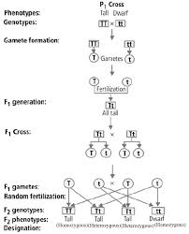

Slide 5
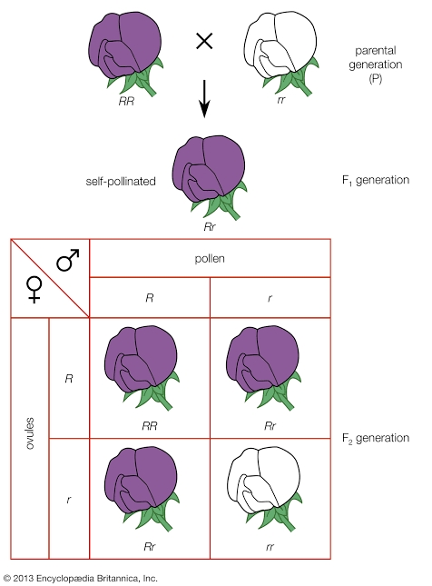

Slide 6
Law of segregation
Each organism is formed of a bundle of characters
Each character is controlled by a pair of genes
Two genes of a particular character remain uncontaminated when they are inside the organism
During gamet formation paired genes segregate and enter different genes
Each gamet contains only one of the paired genes

Slide 7
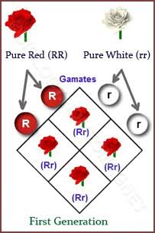

Slide 8
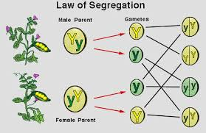

Slide 9
Law of independent assortment
Genes for each pair of characters separate independently from those of other characters during gamet formation
This law is based on dihybrid experiment
Yellow colour assort out independently of the factors for round
Gene Y may be combined with R or r

Slide 10
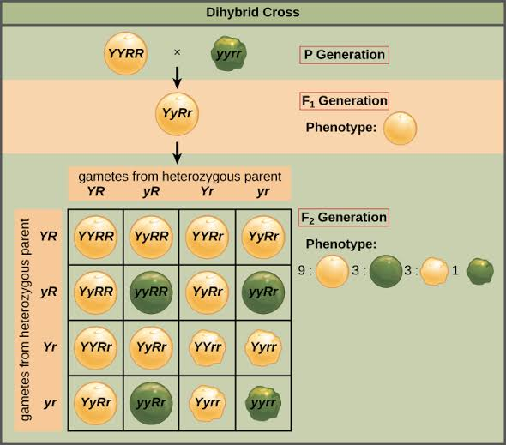

Slide 11


