Slide 1
X linked inheritance
By Dr. B.padmaja D.n.r.college

Slide 2
Definition
Certain sex linked genes are located only on X chromosome
Their allele s are absent from Y chromosome
These genes are called X linked genes
Characters controlled by these genes – X characters
Mode of inheritance– X linked inheritance
. Eg: Colour blindness
Haemophilia Eye colour in drosophila

Slide 3
Colour blindness
Discovered by Wilson 1911
Cannot distinguish Red and green colours Red blindness --- protonopia
Green blindness--- Deuteronopia
Colour blindness is a recessive character
Caused by recessive genes represented by cc Genes for colour blindness are located on X chromosome alleles are absent on Y

Slide 6
Haemophilia ( Bleeders disease)
It is a hereditary disease discovered by JOHN COTTO 1803
Delayed blood clotting -- absence of abtihaemophilic globulin
Clotting is delayed for 20 minutes
It is a sex linked recessive character and the genes are located on X chromosome
Caused by recessive genes hh Sex linked character is common in men rare in women
It follows criss- cross inheritance

Slide 8
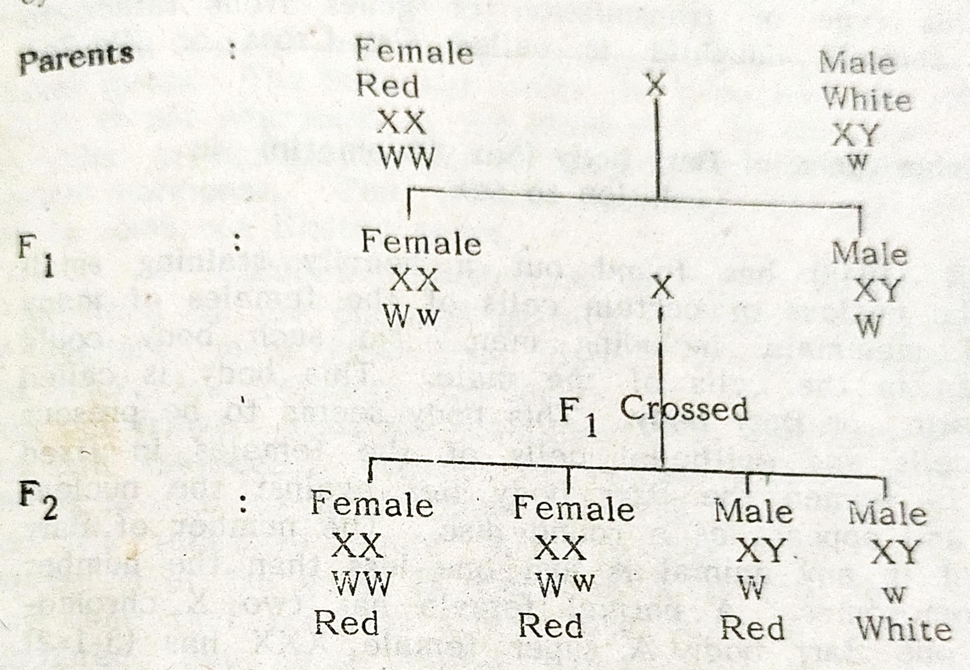
Eye colour in drosophila
Red eye colour is dominant (WW) over white (ww)

Slide 9
In this cross red female transmits the gene for red eye colour (W) to all F1 offsprings through X chromosome
White eyed male transmits white colour gene to his white eye colour gene to his daughter through X chromosome
Hence F1 offsprings are red eyed F1 is interbreed white appears in ¼ th of the F2 generation as in mendel’s monohybrid experiment
Of the F2 offspring, all the females are red But, among the males half are white eyed

