Slide 1
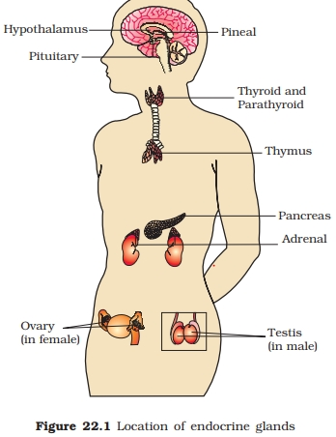
By Dr.B.Padmaja D.N.R.College
Endocrine glands
Pituitary gland

Slide 2
Pituitary gland
Thyroid gland
Parathyroid gland
Adrenal gland pancreas
Testis Ovary Placenta

Slide 3
Introduction
Hormones are Messenger molecules act on target cells
These are chemical messengers produced and secreated into blood
They act as catalysts
Low molecular weight --- they can pass through capillary wall and plasma membrane

Slide 4
Functions
Contraction of muscles
Secretion of enzymes
Digestion
Growth
Metamorphosis
Moulting
Regeneration
Gonad maturation
Sexual cycle Birth Development of secondary sexual characters

Slide 5
Pituitary gland
Pituitary or hypophysis --- master gland
Attached to brain by a stalk--- pituitary stalk Consists of 3 lobes Adenohypophysis(ant. Lobe)
Pars intermedia Neurohypophysis (post. Lobe)

Slide 6
Hormones from anterior pituitary
Growth hormone (STH)
Adreno corticotrophic hormone ( ACTH)
Thyroid stimulating hormone (TSH)
Follicle stimulating hormone (FSH)
Luteinizing hormone ( LH)
Leuteotrophic hormone (LTH)
Melanocyte stimulating hormone (MSH)

Slide 7
Growth hormone (GH or STH)
Secreated by acidophil cells of adenohypophysis
Stululates multiplication
Increases body growth stimulates growth muscles
Stimulate growth of thymus
Increases protein synthesis
Increases intestinal absorption of calcium

Slide 8
Hyperactivity In children Gigantism Symptoms: tall body, thyroid becomes enlarged & hyperactive
Sweating increased Vision disturbed and voice becomes deep Drowsiness
Females become sterile, menstrual disturbances
Hyperglycemia and glycosuria are produced
Adrenal cortex becomes hyperactive
Hyperactivity In adults Acromegaly
Over growth of two jaws Hands and feet are enlarged
Bowing of spine
Abnormal skeleton growths – gorilla like appearance
Hyper glycemia and glycosuria are produced
Sweating is increased
Basal metabolic rate is increased
Females become sterile, menstrual disturbances developed

Slide 9
Hypo activity in children
Dwarfism:
There are two types of dwarfs:Lorain- levy type, Frohlich’s type Lorain- Levy type: produced by hypoactivity of acidophil cells
Stunned growth – adults grow upto 3 ft height
Sex organs and secondary sexual characters donot developed
Frohlich’s type: stunned growth, sexual and secondary sexual characters do not developed
Generalised obesity, appearance of affected males resembles females

Slide 10
Adreno corticotrophic hormone or ACTH
Stimulates the activity of adrenal cortex
Deficiency – rheumatoid fever, Addison’s disease
Thyrotrophin or thyroid stimulating hormone (TSH)
It stimutates thyroid gland-- increasing the thyroxine secretion
Follicle stimulating hormone or FSH
In females, it increases the number and size of graffian follicles
In males, it stimulates the testis for spermatogenesis

Slide 11
Luteinising hormone (LH)
LH secreated by anterior pituitary
It makes graffian follicles grow and mature
It causes graffian follicles to secreate another sex hormone– oestrogen
LH causes the appearance, growth and persistence of corpus luteum in ovary In males, it stimulates interstitial cells of testis and consequently the production of androgen

Slide 12
Leuteotrophic hormone (LTH)
Helps in initiating milk secreation in the breast
Helps corpus luteum in the secretion of projesteron in co-operation with LH Melanocyte stimulating hormone (MSH)
It effects melanophores

Slide 13
Posterior pituitary Vasopressin Oxytocin
It is released in response to stress dehydration
Constricts capillaries, causing the rise of blood pressure
Causes contraction of muscles of urinary bladder, ureter, stomach and intestine
Deficiency of this hormone--- diabetes insipidus
Oxytocin Causes contraction of mammary glands---- ejection of milk Promotes fertilization
Contraction of pregnant uterus – expulsion of foetus and placenta

