Slide 1
Hormonal control on reproduction
By
Dr. B . Padmaja
D N.r.colkege

Slide 2
Hormonal regulation of pregnancy
Hormonal regulation of ovulation
Hormonal regulation of birth

Slide 3
Hormonal regulation of ovulation
FSH
Relaxin
Gonadotrophic
Hormones
LH
Oxytocin
LH

Slide 4
FSH: Growth of graffian follicles
LH:. Ripening of graffian follicle
Stimulate ovary to secreate – oestrogen
Brings about ovulation in assistance with oestrogen
Stimulates the formation of corpus luteum from the ruptured follicle
Stimulate corpus luteum to secreate oestrogen and progesterone
Oestrogen: increases blood supply to uterine epithelium
Sexual behaviour of female is changed
Stimulate pituitary gland to secreate LH and LTH
Inhibits further secretion of FSH

Slide 5
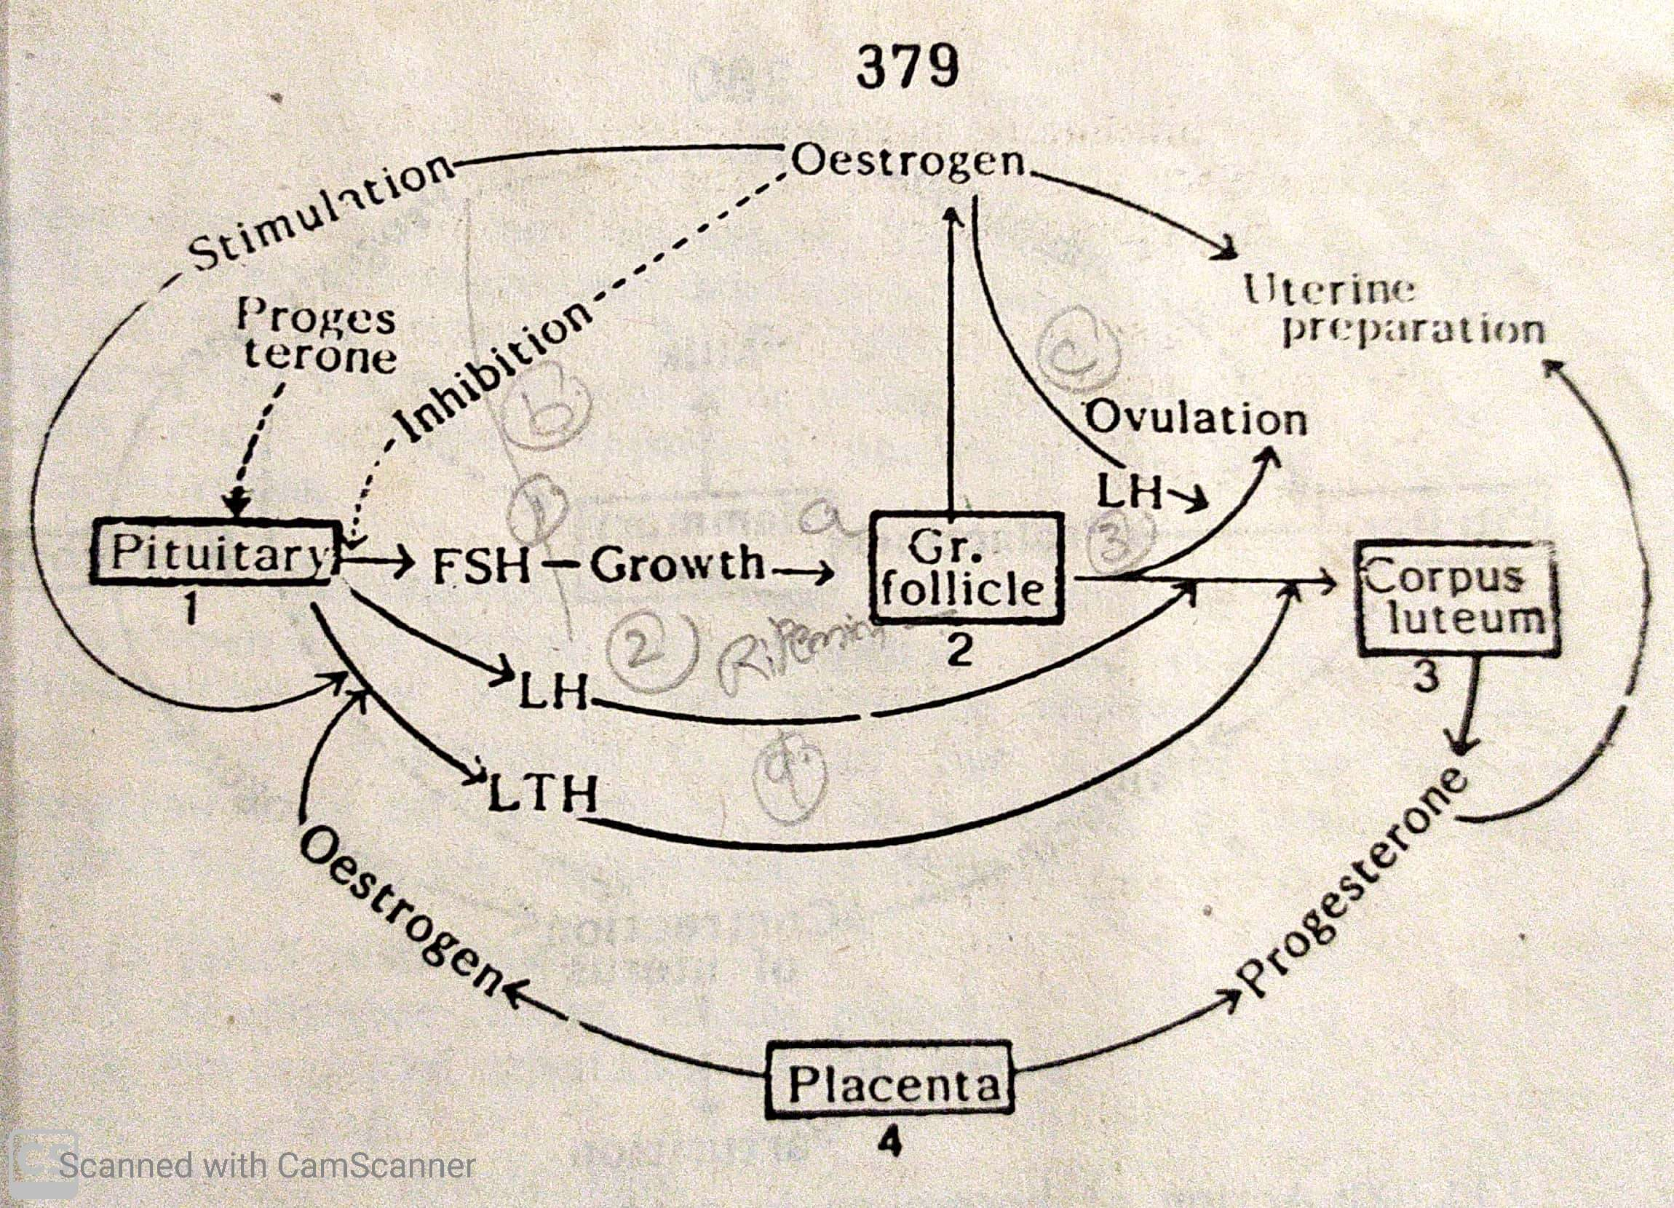

Slide 6
Hormonal regulation of pregnancy
After ovulation, ruptured follicle is transformed into– corpus luteum
It is formed by the influence of leutinizing hormone (LH)
Corpus luteum secreates two hormones : Progesterone, Relaxin
Functions of progesterone: Along with oestrogen, it causes the increase of blood supply to the uterine epithelium
It makes breast sensitive
Inhibits the secreation of FSH
Egg is not fertilized, corpus luteum degenerate and converted into corpus albicans
When egg is fertilized, it enters into uterus
When placenta develoos, it secreats large amount of oestrogen

Slide 7
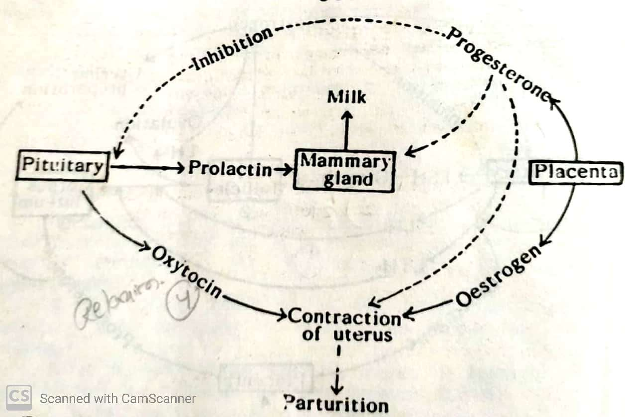
Hormonal regulation of birth

Slide 8


