Slide 1
Structure of Nephron and Urine formation
By
Dr.B.Padmaja
D.N.R. College

Slide 2
Introduction
Functional unit of the kidney
In man, each kidney formed of 1million nephrons
Nephron is a coiled tubule --- length of 3cm
----width ---- 20-60 microns
Total length--- 65kms

Slide 3
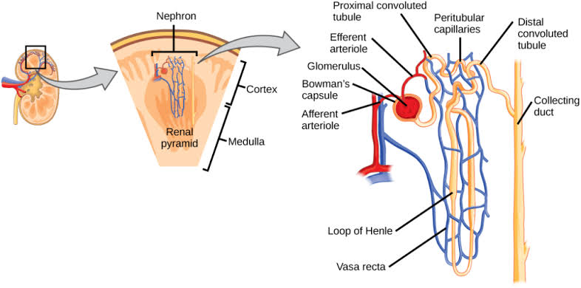

Slide 4
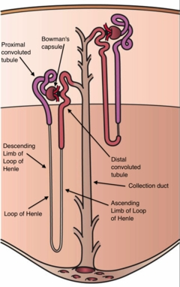
Malphigian corpuscle---Bowmans capsule + glomerulus
Bowman’s capsule--- double walled
Space lying between two walls
– capsular space
Cavity of cup contains network of capillaries– Glomerulus
Afferent and efferent arterioles supplies blood
Proximal convoluted tubule ---- Descending limb ----- Henley loop ---- Ascending tubule---Distal convoluted tubule --- collecting tubule

Slide 5
Formation of Urine
Ultra filtration
Reabsorption
Secretion

Slide 6
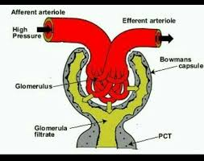
Ultra filtration

Slide 7
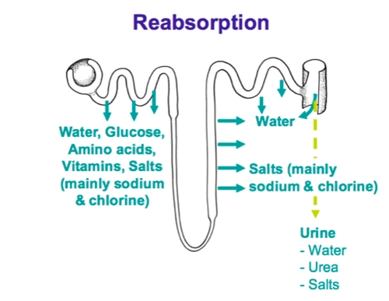
Glomerular Filtrate
Renal fluid
Urine

Slide 8
Substances
Reabsorbed
Amino acids, glucose, proteins, phosphates– proximal
Sodium chloride, bicarbonates– proximal, distal tubule
Potassium– proximal and it is secreated into distal tubule
Water– distal, collecting duct
Sodium – Ascending limb

Slide 9
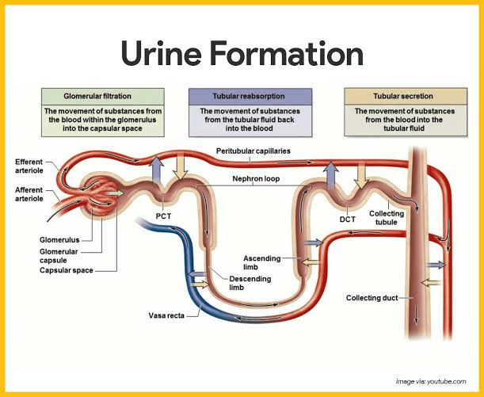

Slide 10
Secretion
Urine contains certain additional substances which are not present in glomerular filtrate
Mainly occurs in convoluted tubules
Aminohippuric acid, is secreated into proximal convoluted tubules
Creatine and phosphates are also secreated

Slide 11
Hair-pin counter current multiplier theory
Theory proposed by WIRZ and BRAY—1960
Entire length is permeable to water except ascending limb
Sodium pumped out of ascending limb– passes iinto the descending limb– diffusion
Sodium again passes into ascending limb through the Henley loop--- recirculation

Slide 12
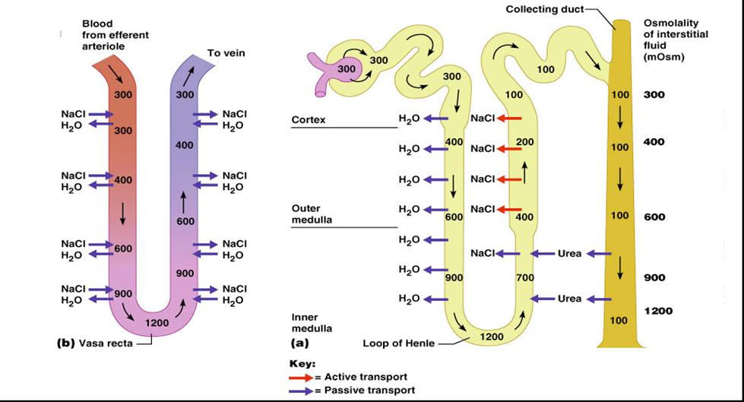

Slide 13


