Slide 1
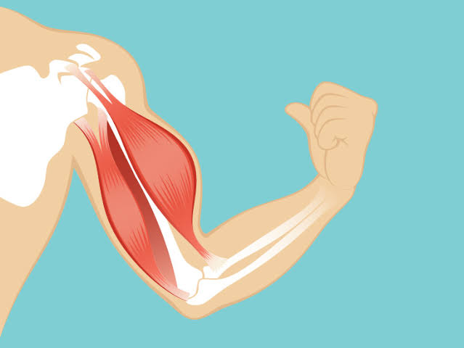
Ultra structure of muscle and muscle contraction
By Dr.B.Padmaja D.N.R. college

Slide 2
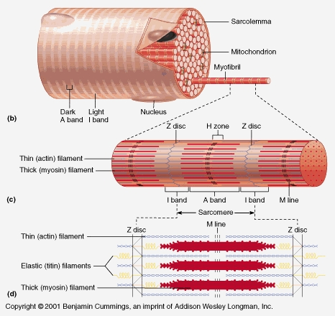
Ultra structure of muscle muscle is formed of several cells--- muscle fibres Length—12 cm Plasma membrane of muscle--- sarcolemma composed of I & a bands At the centre of l band---, z line H zone is at the centre of A band Region between two z line-- sarcomere

Slide 3
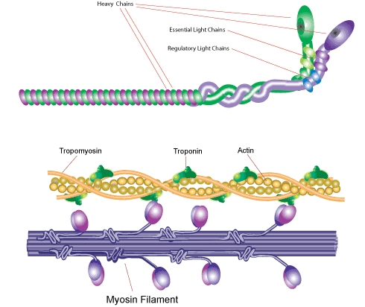
Sarcomere consists of 2 kinds of longitudinal filaments--- thick and thin filaments
Thin filaments are attached toZ line at one end; other end-extend towards the middle of sarcomere and are free Thick filament– composed of– myosin
Myosin --- Rod like and has at one end --- head Thin filament ---- 3 proteins--- actin, tropomyosin, troponin

Slide 5
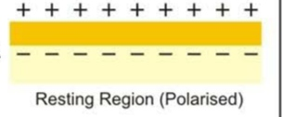
Nerve fibre is a long tube --- filled with axoplasm and covered by plasma membrane
Resting fibre ----- axoplasm contains more potassium Outside the nerve, more sodium
Resting nerve membrane more permeable to potassium--- more potassium transported from inside to the outside
At the same time, sodium also transported
The axoplasm contains large amt. Of _ve charged ions Hence, out side of nerve--- +ly charged and inside-ve charged

Slide 6
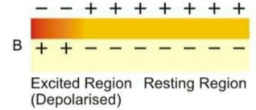
Stimulated nerve
Membrane--- more permeable to sodium--- more sodium move in and less potassium
As a result--- inside nerve fibre becomes+ve and outside-ve charged

Slide 7
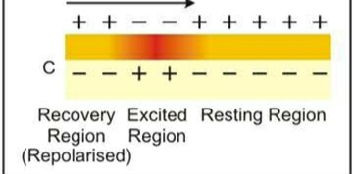
Repolarised state
The membrane --- more permeable to potassium
Hence more potassium move out and less sodium
Nerve fibre is ready to conduct next impulse

Slide 9
Conduction in myelinated fibre

