Slide 1
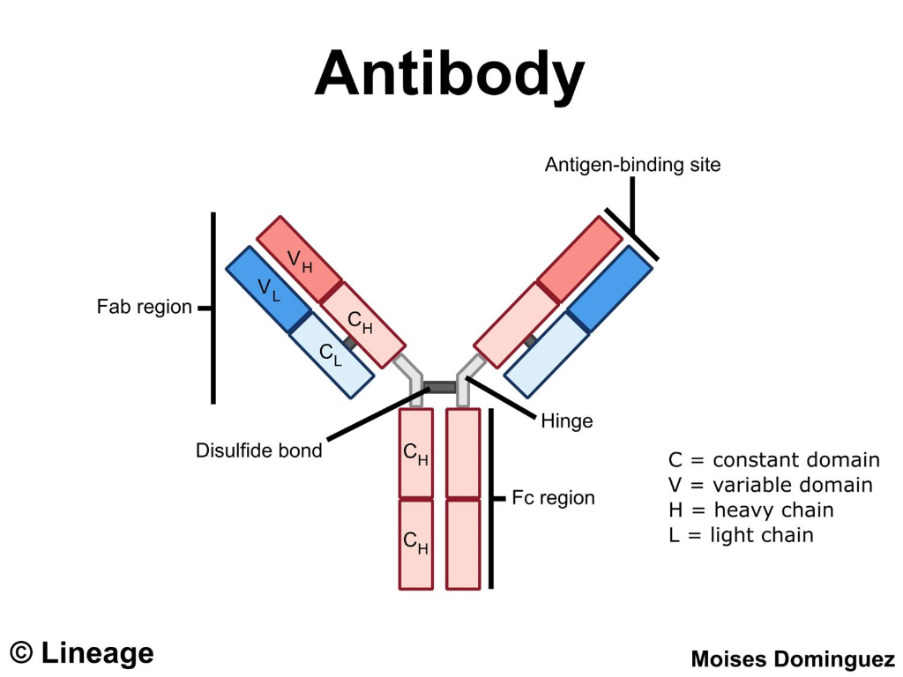
DR.K.Usha Rani
Lecturer In Zoology
DNR College, Bhimavaram

Slide 2
Introduction
A protein made by plasma cells (activated B lymphocytes) in response to an antigen (a substance that causes the body to make a specific immune response).
The earliest reference to antibodies came from Emil von Behring and Shibasabura Kitasato in 1890. The term denotes the factor is “against the body (foreign body)”.
It is composed of globulin proteins, thus it is also known as “gammaglobulin”.
It protects the body by neutralizing the antigens

Slide 3
Structire Of Antibody
It is Y-shaped structure consisting of four polypeptides – two heavy (H), and two light (L) chains.
It can be divisible into two regions – a Fab (Fragment antigen binding) region and a Fc (Fragment crystallizable) region
Fab fragment contain antigen binding site or paratope that binds to epitope of an antigens. It is composed of one constant (C) and one variable (V) domain of each heavy and light chain. Variable domain of both chain makes the paratope.
Fc region is the tail region that interacts with cell surface receptors called Fc (Fragment crystallizable) receptors, and some proteins of the complement system to activate immune system. The Fc regions of antibody carry a highly conserved N-glycosylation site.

Slide 4
The heavy chain and light chains are joined together by one interchain disulfide linkage. Variable and constant region of both chains have intrachain disulfide linkages.
Both heavy chains are joined together by at least two interchain disulfide linkgages and a hinge. Each heavy chain also contain at least two intrachain disulfide
Two types of disulfide linkage: Interchain and intrachain linkage e linkages

Slide 5
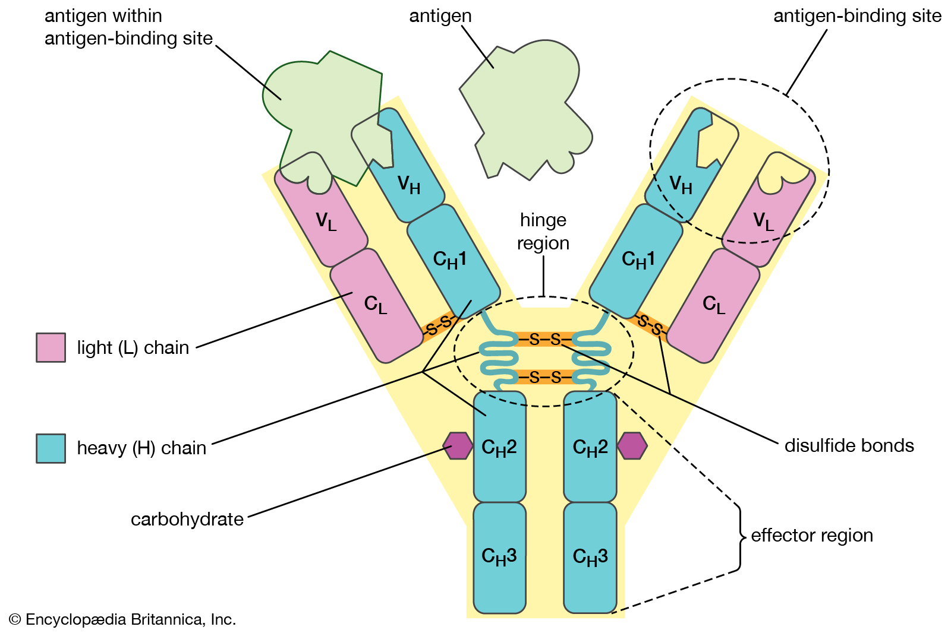

Slide 6
Classification
There are five classes or isotypes of gammaglobulin, i.e., antibody molecules found in the serum: IgG, IgM, IgA, IgE, and IgD. They induce distinct effector mechanism in response to antigen.
Expression of distinct isotype in B cell upon coupling of BCR to unique antigen is called isotype switching, which is facilitated by the enzyme AID (activation-induced cytidine deaminase).
IgG is a predominant antibody and constitute about 80% of antibody in the serum.
IgA and IgD confer mucosal immunity; IgA only neutralizes the antigen at mucosal surface, while IgD also interacts with BCR.
IgE binds to allergen and induces allergic responses.
IgG and IgM are responsible for systemic immunity.

Slide 7
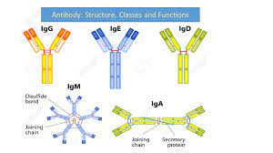

Slide 9
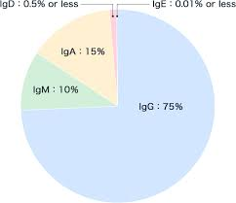

Slide 10
Diversity Of Antibody
There are millions of antigens/epitopes present in the environment.
Our immune system has the ability to produce specific antibody to each unique epitope.
This diversification in antibody is known as antibody diversity.
There are at least 10,530 types of H chain and about 200 types of L chains in the mammals, therefore expected types of antibodies will be 2,106,000

Slide 11
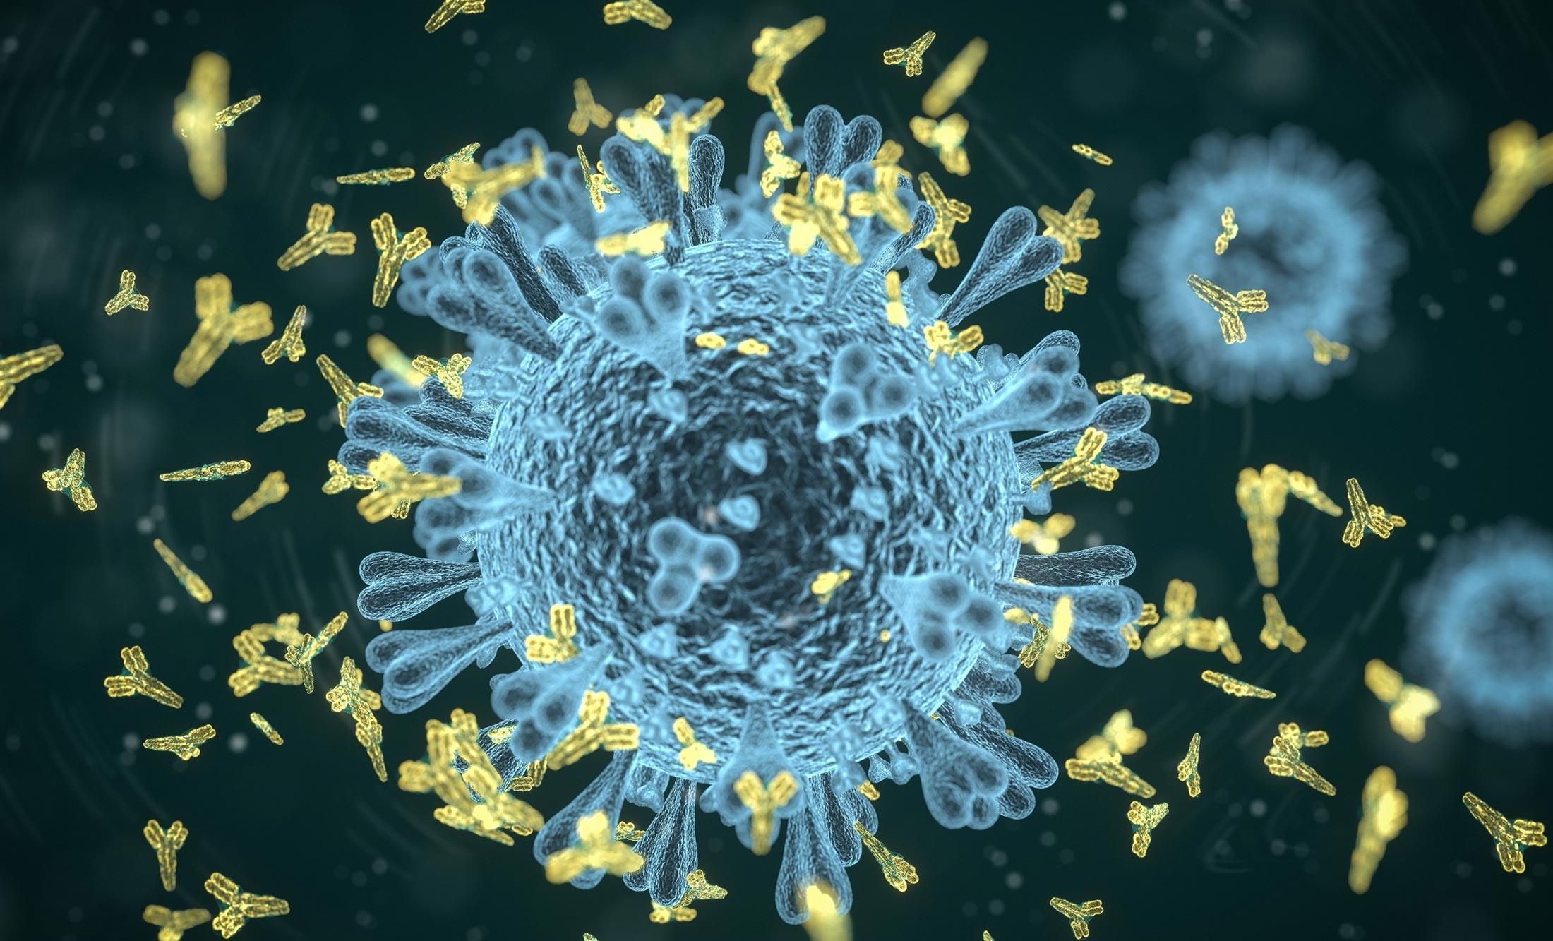
THANK YOU

