Slide 1
Secondary lymphoid organs
By
Dr.B.padmaja
Associate professor
D.n.r.college

Slide 2
These are concern with immune reactions
The cells Are exposed to antigens and they produce antibodies
Lymph nodes
Spleen
MALT

Slide 3
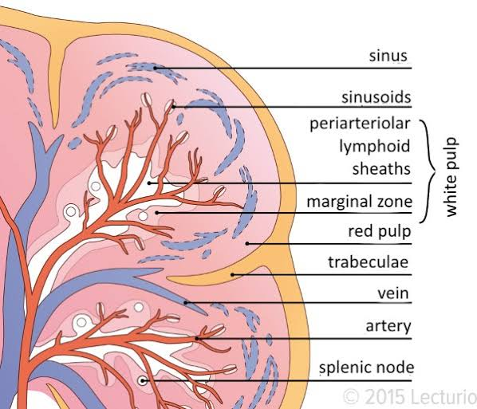
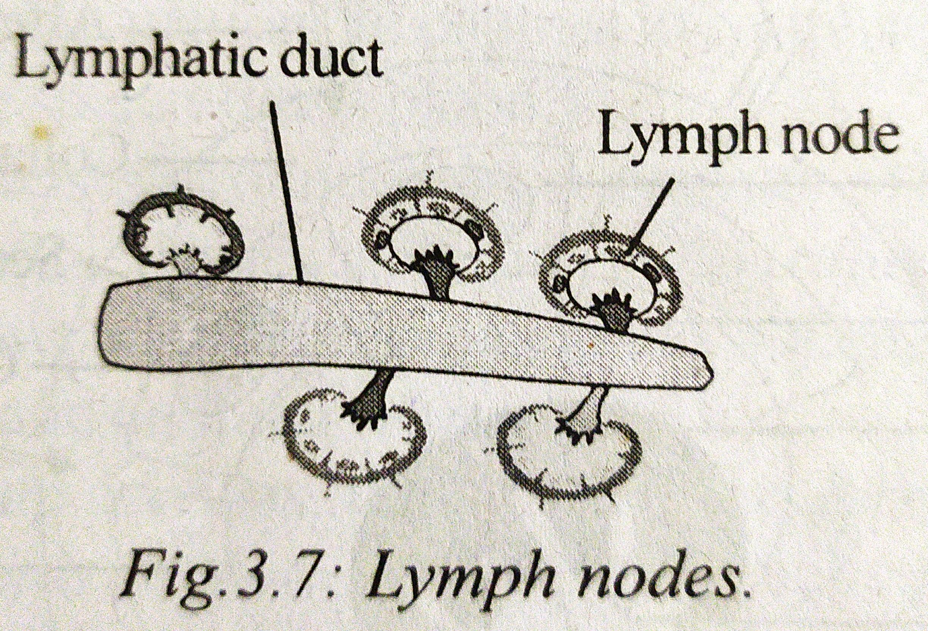
Lymph node
Bean shape
1.2 mm in diameter
One side, hilus is present Where blood vessels enter
Efferent lymphatic duct carry lymph into the gland
Efferent lymphatic duct leave the node

Slide 4
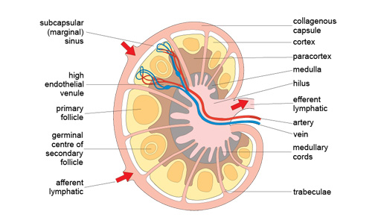

Slide 5
Functions
Important centres of phagocytosis
Responsible for Initiation and development of cell mediated and humoral immunity

Slide 6
Spleen
It is a secondary lymphoid organ
Located on upper part of abdominal cavity
Deep red colour

Slide 8
Functions
Graveyard for worn out blood cells
Reserve tank for formation of RBC
Acts as filter for trapping foreign particles
Brings about cell mediated and humoral immunity

Slide 9
Thank you

