Slide 1
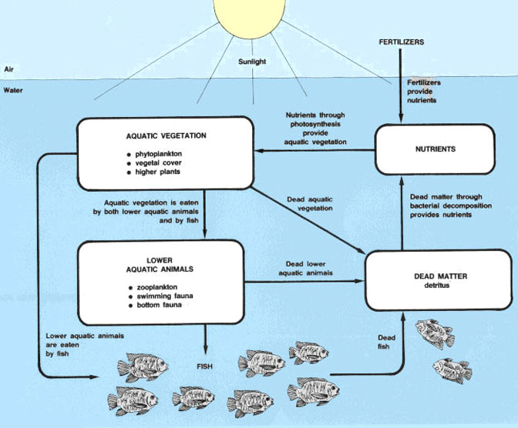
Fertilization of fish ponds
Dr.K.Usha Rani
Lecturer in Zoology
DNR college,
Bhimavaram

Slide 2
The primary purpose of fertilization is to increase its productivity by increasing the essential nutrients is to direct all the primary, secondary and tertiary levels of productivity towards the maximum yield of fish.
Ensure a more hygienic, economic and simpler means of increasing fish production compared to artificial feeding.
Organic fertilizers- Cow dung Poultry manure Compost fertilizer, sillage, sewage, oil cakes, etc.Considered more preferable due to:
Provide ready-made mass of organic matter containing all the necessary nutrients
Stimulate the growth of bacteria Useful for conditioning the structure of soil
Release nutrients at slow rate thus sustaining fertility of water over a long period
Comparatively cheaper

Slide 3
Inorganic fertilizers May be grouped as under:
Limestone & lime
Phosphorus
Nitrogen
Potassium
Magnesium
Trace elements
At present mostly DAP & Urea are used to provide most of the necessary elements in fish pond

Slide 4
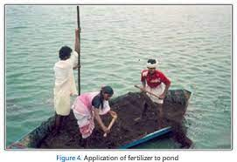
Frequency of Application
The ideal frequency of fertilizer application probably varies from place to place, but 2-4 weeks of interval is adequate.
The most critical and often most difficult aspect of pond preparation is initiation of phytoplankton bloom in the spring or at beginning of a crop. Larger or more frequent applications of fertilizers may be needed to initiate phytoplankton bloom

Slide 5
Method of application
Broadcasting -Solid, granular fertilizers often are broadcast over pond surfaces. Fertilizers do not dissolve completely while settling through the water, but they finish dissolving while laying on the pond bottom
Platforms and bags -This method prevents phosphorus fertilizer from settling to the pond bottom,apparently decreasing the rate at which phophorus from the fertilizer is adsorbed by bottom muds. This method reduces fertilizer requirements by 20-40%.
Liquid fertilizers-the most common liquid fertilizer for agriculture are solutions of ammonia and urea. Two liquid fertilizers, phosphoric acid and ammonium polyphosphate are considerable use in aquaculture. this fertilizers should be stored in mild steel containers.Liquid fertilizers are denser then water, if they are poured directly into the water, they will flow to pond bottom as a density current.

Slide 6
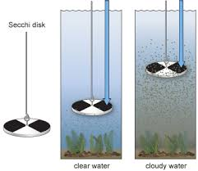

Slide 7
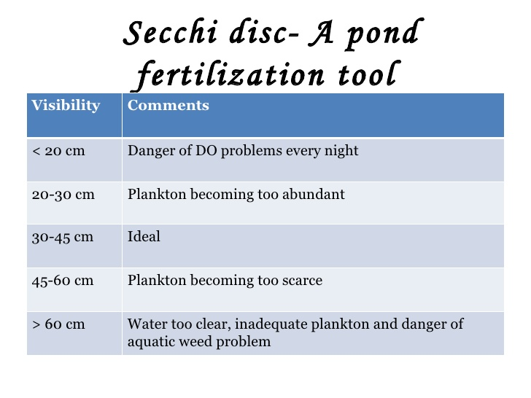

Slide 8
Disadvantages if used more
There is a risk of oxygen depletion in hyper-eutrophic inorganically fertilized ponds due to plankton respiration, but dissolved oxygen problems are much more prevalent in ponds fertilized with organic fertilizers due to the oxygen requirement for decomposition.
Care must be taken when adding organic matter to ponds. Relatively small, daily additions are usually recommended.
Most inorganic fertilizers containing N hydrolyze to ammonia, which can lead to fish toxicity at the high afternoon pH levels typical of fertile fish ponds.

Slide 9
THANK U

