Slide 1
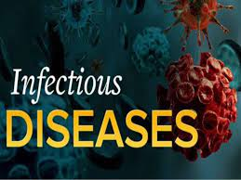
Fish diseases
Dr.K.Usha Rani
HOD Zoology
DNR college, Bhimavram

Slide 2
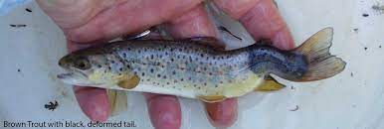
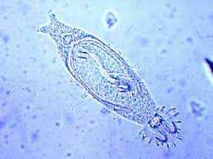
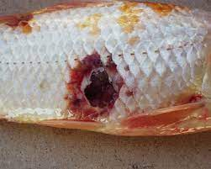
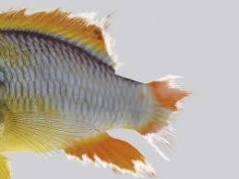

Slide 3
INTRODUCTION
The dynamics of the occurrence, severity and spread of diseases within and between fish populations are similar to those associated with diseases in human and terrestrial animal populations. However, one additional component in fish populations is the water environment which may facilitate the spread of disease-causing agents.
Diseases are transmitted from one individual to another in one of two ways: vertical transmission or horizontal transmission. In vertical transmission, pathogens are transmitted from one or both parents to offspring through sex cell which for offspring. Horizontal transmission involves the spread of the pathogen from one individual to another through direct contact, air, or water.

Slide 4
Successful fish health management begins with prevention of disease rather than treatment. Prevention of fish disease is accomplished through good water quality management, nutrition and sanitation.
The fish is constantly bathed in potential pathogens, including bacteria, fungi, and parasites.
Sub-optimal water quality, poor nutrition or immune system suppression generally associated with stressful conditions allow these potential pathogens to cause disease.

Slide 5
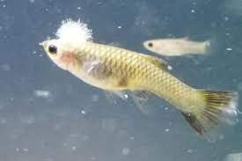
FUNGAL DISEASE - Saprolegniasis

Slide 6
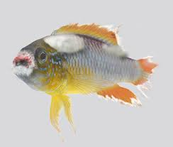
Tail and fin Rot disease

Slide 7
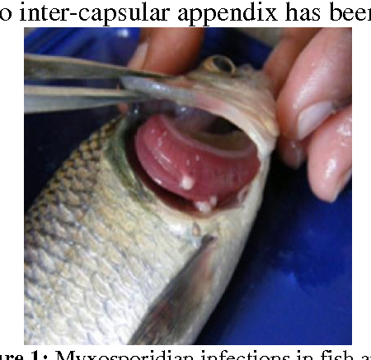
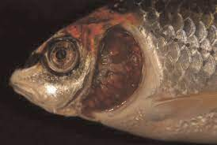
Myxoboliasis

Slide 8
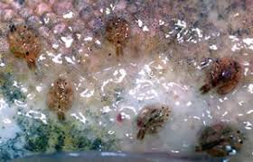
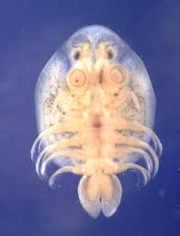
ARGULUS

Slide 9
