Slide 1
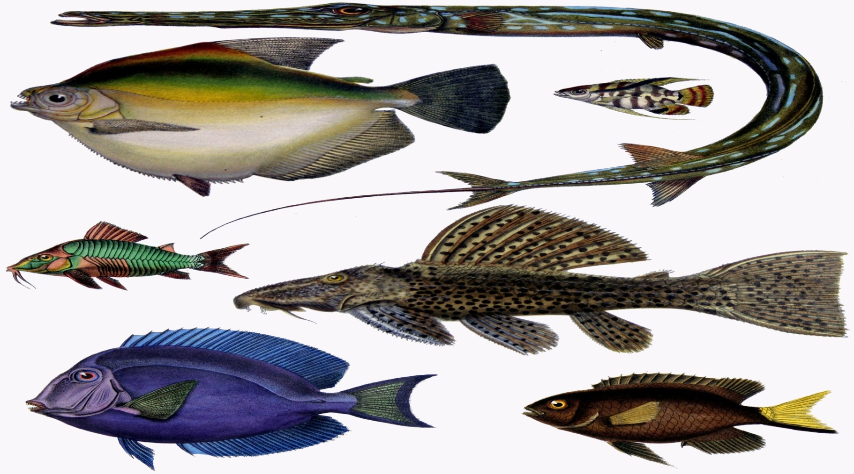
Amazing Diversity of Fishes & Prawns
Dr.K.Usha Rani
Lecturer in Zoology
DNR College, Bhimavaram

Slide 2
Characters of fishes
Fishes are aquatic; cold blooded vertebrates.
Their body is divisible into head, trunk and tail. Neck is absent.
It has a spindle shaped body. It is helpful in swimming.
The body is covered by scales. They are placoid scales, cycloid scales, ctenoid scales, ganoid scales etc.
Respiration is by gills. Gills are the extensions of the pharynx. In the elasmobranches fishes, the gills will open separate. In bony fishes the gill slits are covered by operculum.
On the head a pair of nostrils are present internal nostril are absent. In Dipnoi Internal nostrils are present
On the head a pair of eyes is present.
On the lateral sides of the body LATERAL LINE SENSE organs are present. They detect the pressure changes of water.
The body shows paired and unpaired fins. Pelvic and pectoral fins are paired. Dorsal and ventral fins are unpaired. They maintain balance in water. They are useful for locomotion.

Slide 3
The digestive system is well developed. In the intestine of shark scroll valve Is present. The nervous system contains brain and spinal cord. Brain is small & it will not occupy the entire cranial cavity.
10 pairs of cranial nerves are present.
Kidneys are mesonephrlc.
Urinary bladder is absent
The skeleton of some fishes is made by cartilage. They are called cartilage fishes. In some fishes the skeleton is made by bone. They are called bony fishes.
In some fresh water fishes accessory respiratory organs are present. They will take up aerial respiration.
Sexes are separate. In male sharks claspers are present.
Many fishes are oviparous. Some fishes are viviparous.
In the development of fishes amnion is not developed. Hence these animals are called anamniotes.

Slide 4
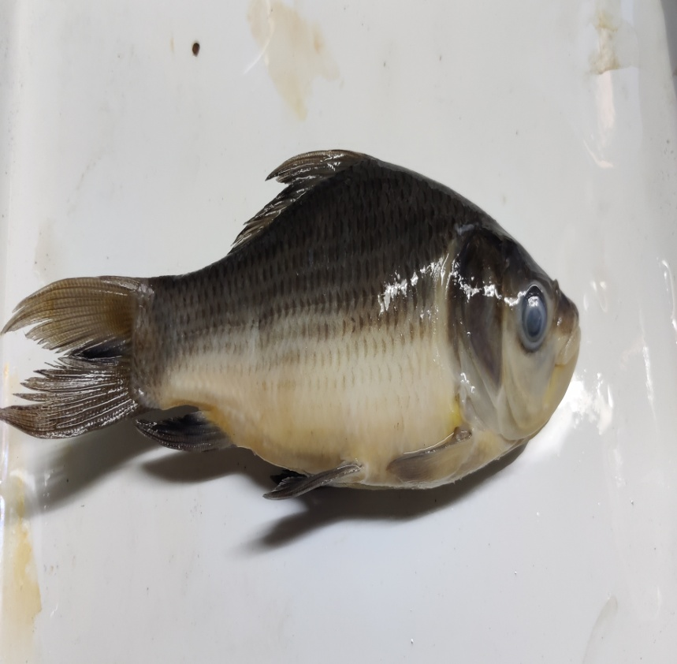
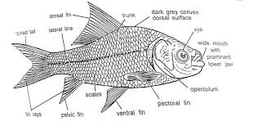
Catla Catla
A
B

Slide 5
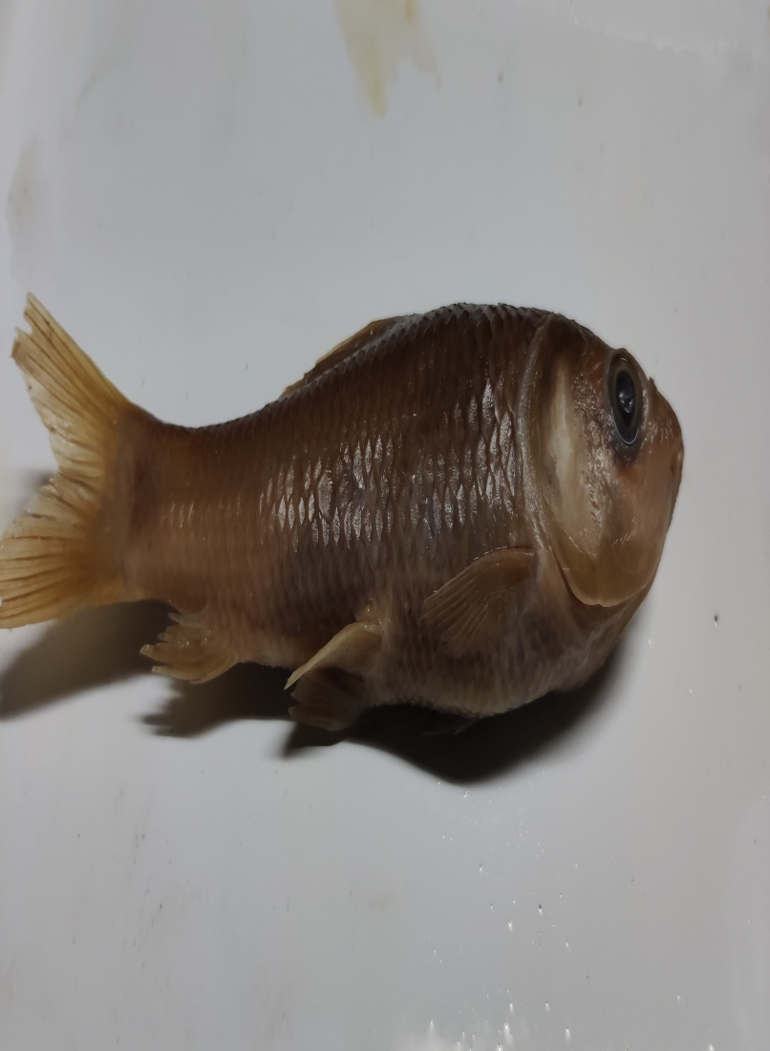
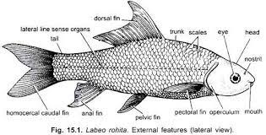
Labeo rohita

Slide 6
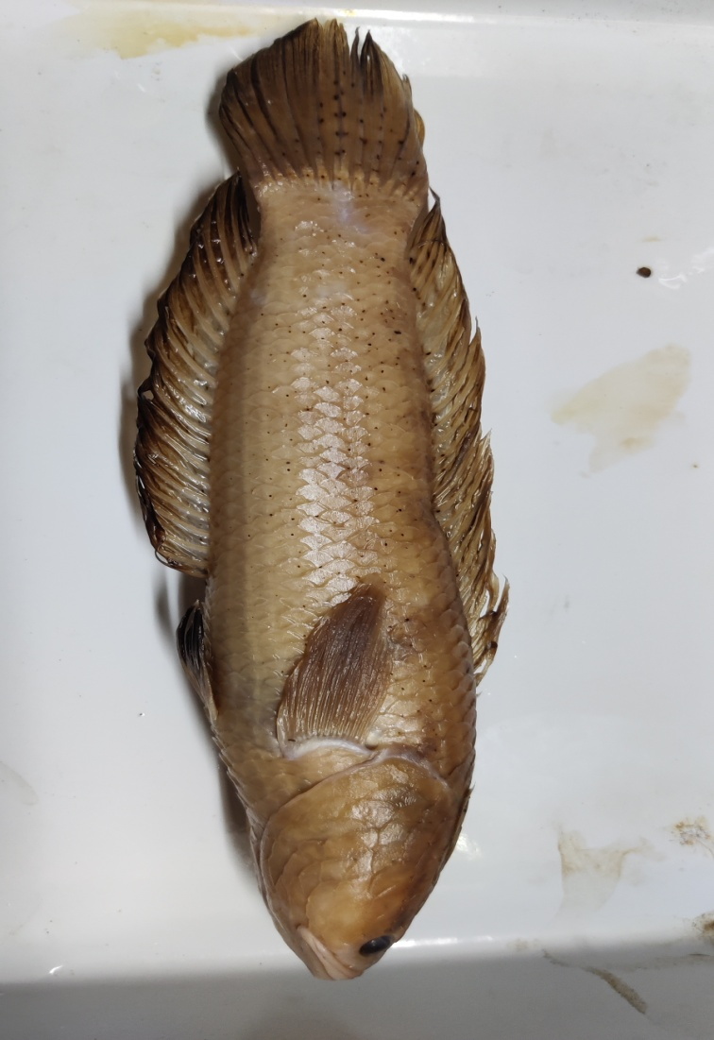
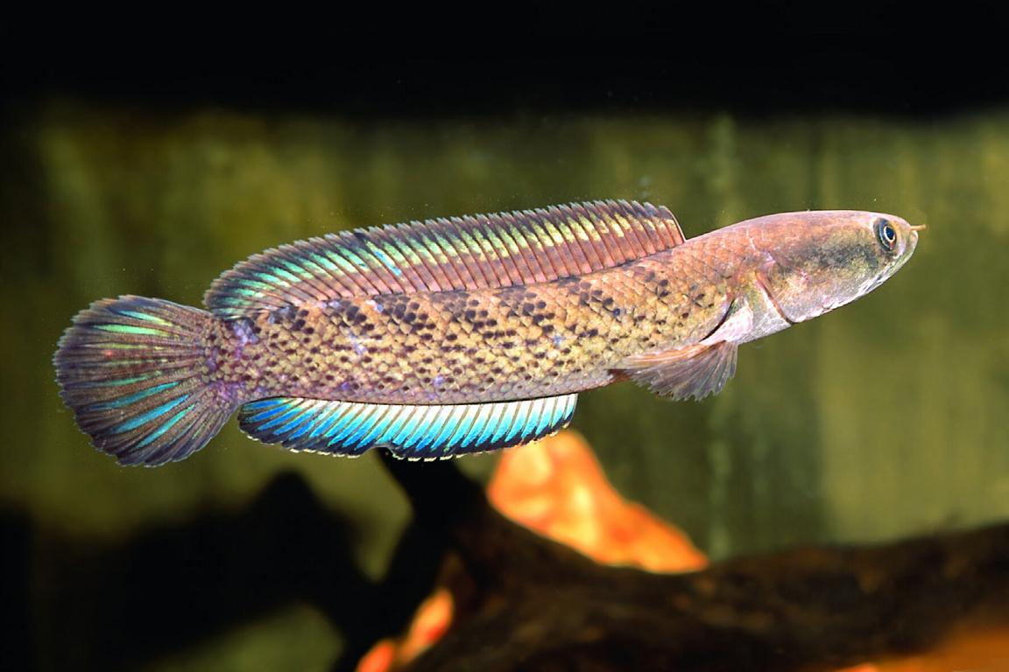
Channa punctata

Slide 7
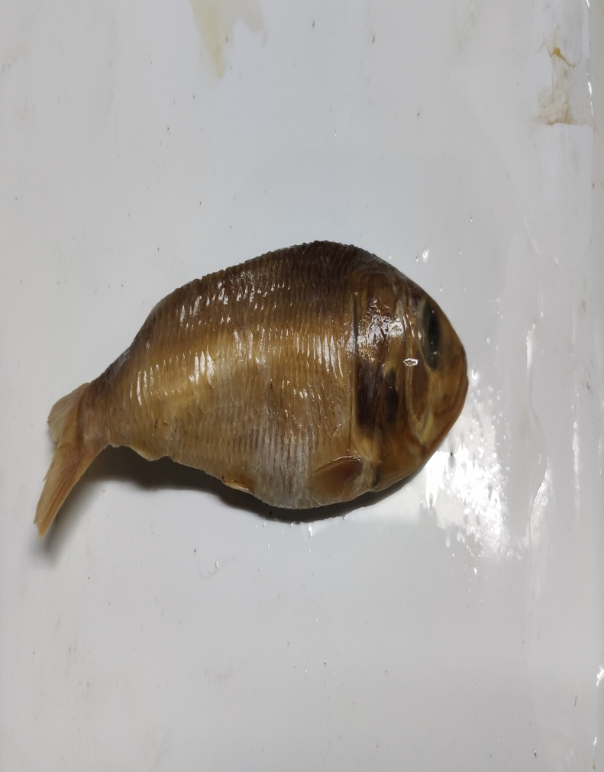
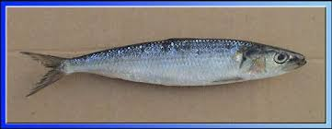
Sardinella longiceps

Slide 8
Characters of prawn in general
Crusta (Latin)= a hard shell
Mainly aquatic, generally marine but few freshwater and few live in moist places
Generally free living but few are parasitic
Head often fused with thorax to form cephalothorax covered dorsally by carapace
Head bears a pair of compound eye and five pairs of appendages

Slide 9
Thorax and abdomen often with a pair of biramous appendages in each segments
Respiration either by gill or general respiratory surface
Coelom greatly reduced, it is in the form of haemocoel
Excretory organs are modified coelomoduct which may be either maxillary gland or antennary (green) glands
Sex usually separate & sexual dimorphism is common
Development includes metamorphosis with free larval stages

Slide 10
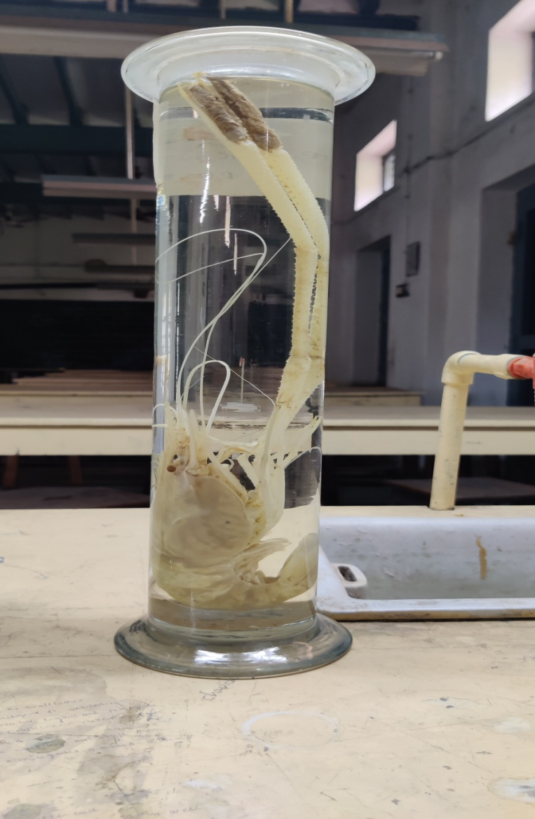
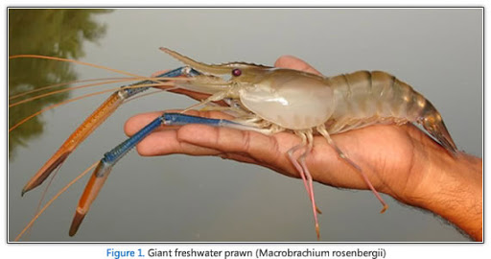
Macrobrachium rosenbergii

Slide 11
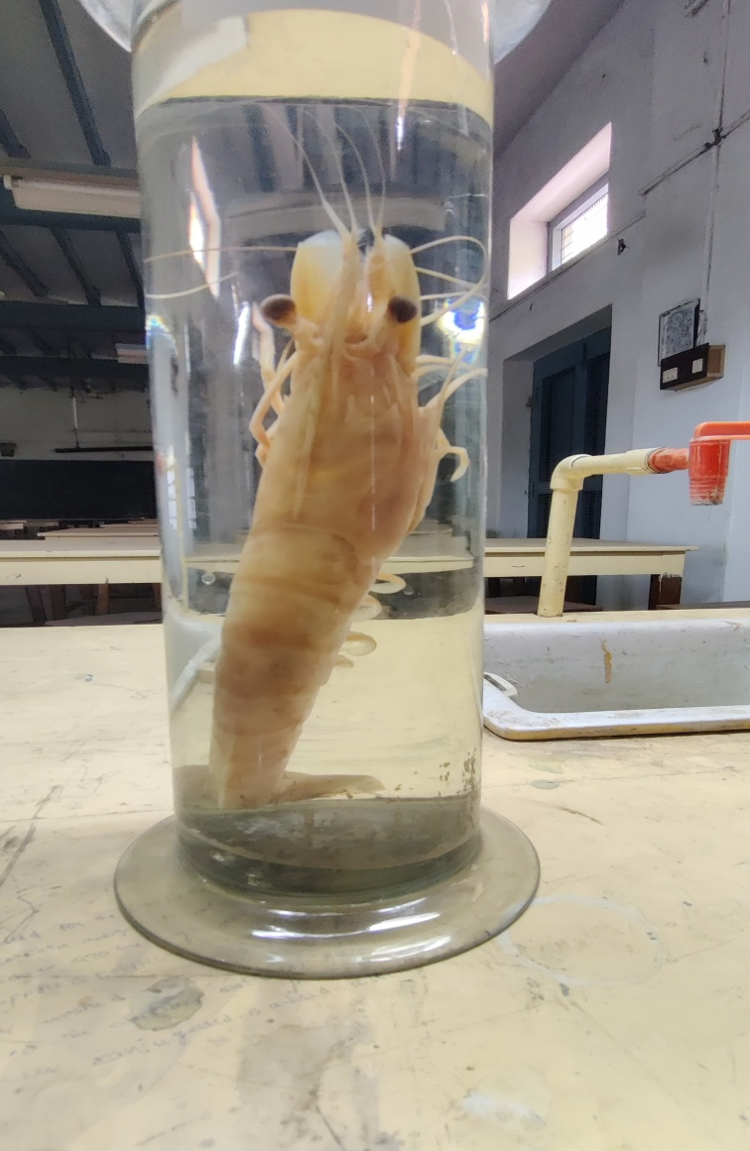
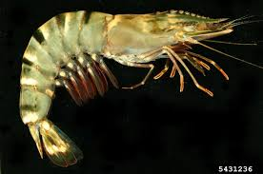
Penaeus monodon

