Slide 1
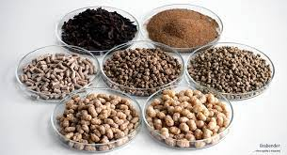
Fish feed and its significance
Dr.K.Usha Rani
Lecturer in Zoology
DNR College,Bhimavaram

Slide 2
Introduction
Though natural food contributes to the nutrition of the cultured fish in semi-extensive and extensive fish culture systems, the exogenous supply of artificial food needs to supply nutrients which maybe deficient in natural food.
Fish production from these systems depends on the natural biogenic potential on the quality and quantity of natural food production in the pond and artificial feed supplied and on the physico-chemical factors of water and soil.
In intensive fish culture systems, where very high stocking densities are maintained (such as cage culture, recirculatory and pond culture systems), the cultured fish has to rely on the artificial feeds.
At high densities, insufficient feeding leads to poor growth and nutritional diseases.Therefore, it is necessary to design and prepare artificial feeds in balanced proportions with all essential nutrients so that the metabolic activities of fish may accelerate immediately after feeding.

Slide 3
feed
Artificial
Natural

Slide 4
Unicellular algae
Lab lab
Blue green algae
Rotifers
Cladocerans

Slide 5
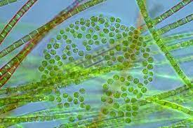
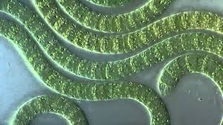
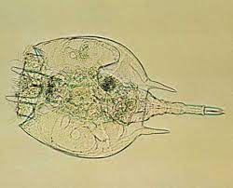
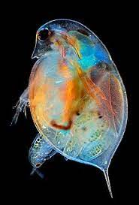

Slide 6
Dry feed
pellets
mash
Crumbles
Non dry feed
Wet feed
Moist feed
Semi moist feed

Slide 7
Dry feeds contain moisture in the range 7-13%.
easy to manufacture, transport, store and convenient to dispense into the culture systems.
advantages : include bulk purchase and storage of ingredients option to select a wide variety of ingredients with specific nutritional characteristics.
can be produced in different sizes to suit the specific needs of the larvae to specialized diets for brood stock.
permit production of specialized feeds such as medicated feeds incorporated with specific medicines or antibiotics required to control any disease out breaks, hormones incorporated feeds to produce monosex individuals or for growth promotion or to induce maturation in fish and prawns.
Dry feeds may be either prepared using dry ingredients alone or a mixture of wet and dry ingredients adequately processed and dried

Slide 8
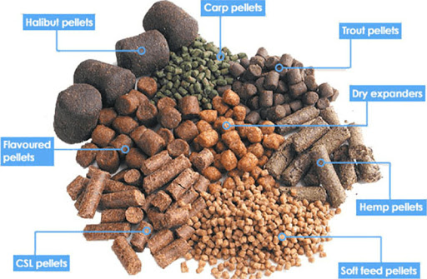

Slide 10
moist feed
Wet feed
Feeds containing moisture levels in the range of 45-70% are prepared from high moisture ingredients such as trash fish, fishery waste, slaughter house waste, etc. ○ These feeds are made at the farm shed on a day-to-day basis and fed mainly to carnivorous fish such as sea bass, sea bream, eels, etc.
Moist feeds
○ moisture level in the range of 25-45%
○ made from a mixture of high moisture ingredients as in wet feeds, and dry pulverized ingredients.
Many fish species find soft diets more palatable than dry diets.
○ A pelleting machine is not needed, a food grinder will suffice ○ Heating and drying are avoided Disadvantages.
○ Susceptible to microbial and oxidation spoilage unless fed immediately or frozen. ○ Should be heated to destroy possible pathogens and thiaminase .

Slide 11
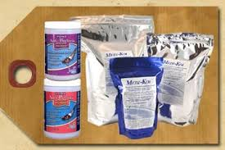
Medicated feed
Any feed which contains drug ingredients intended or presented for the cure, mitigation, treatment, or prevention of disease of animals other than man or which contains drug ingredients intended to affect the structure or any function of the body of animals other than man E.g. : antibiotics incorporated feeds

Slide 12
Conclusion
Based on their uses in farming practice Supplementary feed
Supplement the natural food sources which supply major nutrients only
Traditional, extensive, modified extensive, semi- intensive Complete feed
Supply all energy requirements, all gross major nutrients and micro nutrients

Slide 13
THANK you

