Slide 1
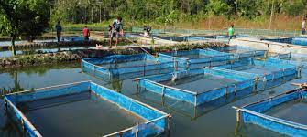
Fish Hatchery
Dr.K.USHA RANI
LECTURER IN ZOOLOGY DNR COLLEGE BHIMAVARAM

Slide 2
Introduction
The major input of aquaculture is availability of quality fish seed. These fish seed comes from natural and hatchery sources.

Slide 3
Hatchery
A fish hatchery is a place for artificial breeding, hatching, and rearing through the early life stages of animals—finfish and shellfish in particular.
Hatchery provides an optimum environment for fish eggs to develop and hatch by maintaining proper water temperature and oxygen levels, and providing adequate food supplies and safety from predators.
Importance of Fish Hatchery:
Hatchery production confers three main benefits to the industry
1. Out of Season Production
2. Genetic Improvement
3. Reduce Dependence on Wild-Caught Juveniles

