Slide 1
CHITOSON PREPARATION & USES
By
Aditya Kumar
DNR. College

Slide 2
Introduction
Can be extracted from crustacean shells through a process involving acid treatment to remove impurities, enzymatic protein removal, bleaching, and deacetylation to produce chitosan

Slide 3
Preparation of chitoson
Chitin is mixed with 40 % solution of caustic soda and heated by indirect steam at 90-100 °C in steam jacketed kettle for 90-120 minutes. During heating, samples are drawn at intervals from reaction mixture washed free of alkali and tested for solubility in 1% acetic acid. Completion of deacetylation is indicated by complete solubility in acetic acid. At the end, caustic soda solution is drained off and residue is washed until free from alkali, dried in sun. Chitosan is pulverized to required mesh size before bagging.

Slide 4
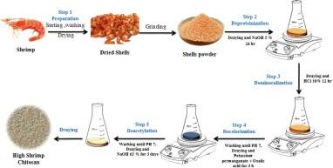

Slide 5
Uses
Used as medicine and in drug manufacturing. Chitosan is a fibrous substance that might reduce how much fat and cholesterol the body absorbs from foods. It also helps blood clot when applied to wounds.

Slide 6
Uses
High blood cholesterol levels (hypercholesterolemia) Weight loss High blood pressure Surgical and other wound healing Gum inflammation

Slide 7
Food application of chitoson
Chitosan as coagulation and flocculation substances in food processing waste water

Slide 8
Industrial uses
Medicine
pharmaceuticals
food, cosmetics
Agriculture
textile
paper industries
energy industry
industrial sustainability

Slide 9
Agricultural uses
used in agriculture as a seed treatment and biopesticide, helping plants to fight off fungal infections.

Slide 10
