Slide 1
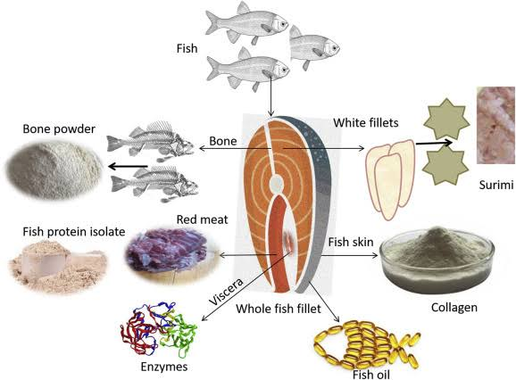
Fish byproducts
Ramya Sri
DNR. College

Slide 2
Introduction
Most of the captured fishes are utilized as food in fresh condition, while several others are distasteful and considered unsuitable for human consumption
the materials discarded during ﬁsh processing .Such inedible fishes and discarded ﬁsh materials form materials for fish by-product industries

Slide 3
Fish meal
With a protein content of 60-75%, it is in great demand by manufacturers of animal feed: especially petfood and aquaculture.

Slide 4
Fish oil
It is an important source of Omega 3 fatty acids and is used in the production of feed, in pharmacological products, in paints and resins, and also as human food: margarines, pastries or dietary supplements.

Slide 5
Protein hydrolyzates
Their demand has been increasing due to their specific use in human food. While it is true that dairy and vegetable proteins are the most widely used due to their greater availability, fish protein also has its niche in this market.

Slide 6
Collagen
It is the fibrous protein and the main component of the intercellular layers or connective tissues.
It is used in cosmetics such as wound dressings, and as a food supplement for the prevention and treatment of osteoarticular problems.
Marine collagen is extracted from the skin and scales of fish

Slide 7
Gelatin
It is used as a stabilizer and emulsifier in the food industry, as an encapsulation excipient in the pharmaceutical industry and also for the manufacture of photographic films, graphic films and X-ray films.
it can serve as a support material for the implantation of stem cells.

Slide 8
Chitoson
. It is found in the exoskeleton of arthropods such as shrimp, prawns, and crabs (and also in fungi and algae). Industries such as textiles, food processing, and wastewater treatment
Is also demanded in the cosmetic product development industry, and is used in pills for weight reduction and in regenerative and anti-inflammatory medicine, among others

Slide 9
Others
Leather, fertilizers, biodiesel fuel and more recently plastic substitutes are also industrially produced from the remains of the fish processing for human consumption –especially viscera, skins, scales and bones
very recent use of Tilapia skin is its effective application for the treatment of burns. As it has a high collagen content and a similar structure to human skin, it helps to regenerate tissue through temporary grafts.

